Slide 1
Physics-Informed Identification of Surface vs. Bulk Degradation Kinetics in Swelling Hydrogels
Kalkidan Gebru
Department of Aerospace Engineering University of Michigan, Ann Arbor

Slide 2
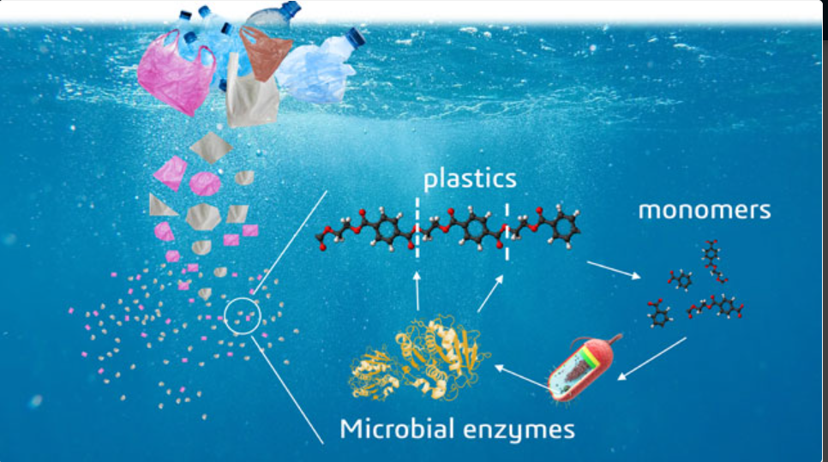
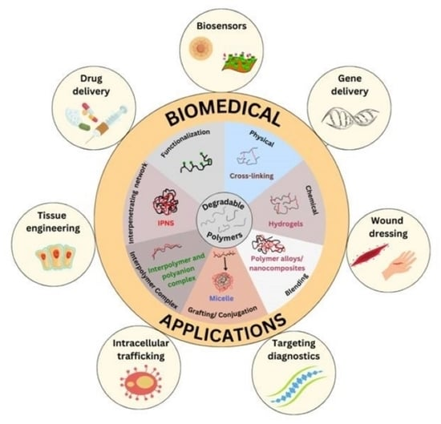
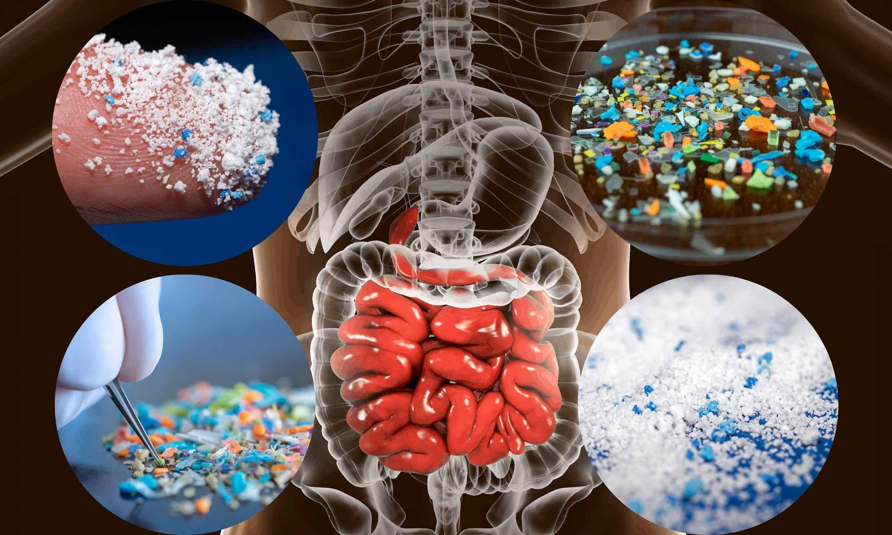
Polymer Degradation
Fig 1-Microbial Enzymatic Degradation of Plastic Waste
in Aquatic Environments
Fig 3-Biomedical Applications of Degradable Polymers
Fig 2-Human Exposure to Microplastics: Ingestion Pathways
and Accumulation in the Digestive System

Slide 3
Overview and Limitations of Current Mechanics Models
Current Continuum Mechanics Models
Used to model hydrogel degradation, swelling, and stress response
Examples: Brassart, Cohen, and others
Advantages
Rigorously grounded in continuum mechanics and thermodynamics
Capture coupled phenomena: diffusion, deformation, and degradation
Disadvantages
Require manual tuning and depend heavily on the modeler’s expertise
Limited generalization to new materials or conditions
Often complex, making them difficult to solve
Motivation: Reduce human involvement while improving prediction accuracy using Neural Networks

Slide 4
Tradeoffs between data requirements and the level of embedded physical laws
Current Models Traditional Neural Network Model-Free Approaches Physics Informed Neural Network (PINN) Physics-embedded Neural Networks(TANNs,CANNs) Challenge: Limited data + high physics fidelity → tradeoff between data & physical constraints.
Physics Laws/ Predictability
Data Requirement

Slide 5
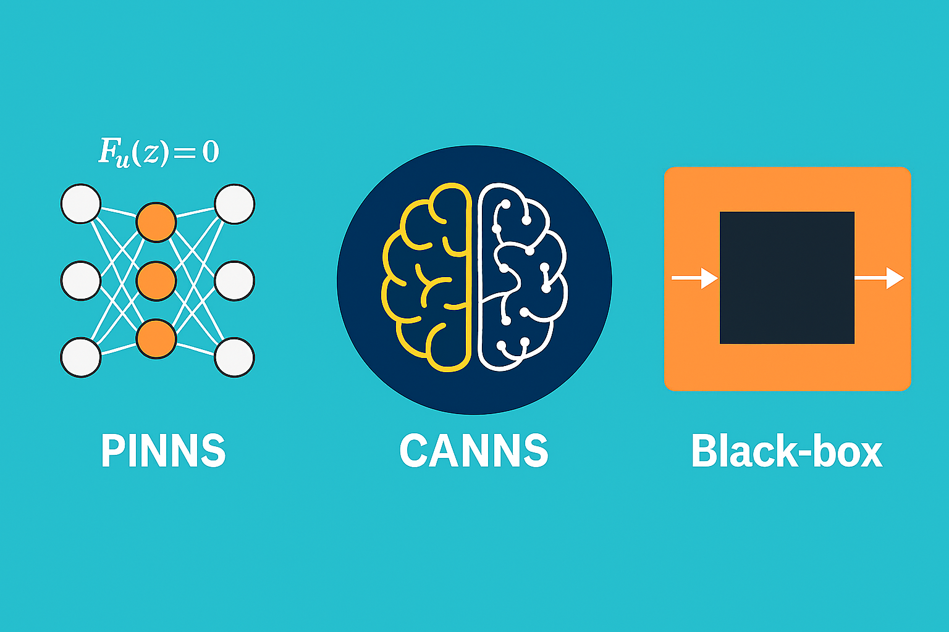
MultiPhysics Inelastic Constitutive Artificial Neural Network
No current ML model directly handles polymer degradation in hydrogels by integrating physical laws
Guarantees thermodynamic consistency
Handles both mechanical deformation
and time-evolving degradation
Holthusen, H., Lamm, L., Brepols, T., Reese, S., & Kuhl, E. (2024). Theory and implementation of inelastic Constitutive Artificial Neural Networks. Computer Methods in Applied Mechanics and Engineering, 428, 117063. https://doi.org/10.1016/j.cma.2024.117063

Slide 6
Overview of Proposed Mechanism
Brassart et Al.- introduces a thermodynamically consistent framework for degradation mechanisms.
Kuhl et Al.- gives you the machine learning architecture to embed those physics in a learnable, predictive, and generalizable way.
Together, they allow you to create a physics-guided AI model for hydrogel degradation that:
Uses few inputs
Respects physics constraints
Pan, Z., & Brassart, L. (2022). Constitutive modelling of hydrolytic degradation in hydrogels. Journal of the Mechanics and Physics of Solids, 165, 104902. https://doi.org/10.1016/j.jmps.2022.104902
Holthusen, H., Lamm, L., Brepols, T., Reese, S., & Kuhl, E. (2024). Theory and implementation of inelastic Constitutive Artificial Neural Networks. Computer Methods in Applied Mechanics and Engineering, 428, 117063. https://doi.org/10.1016/j.cma.2024.117063

Slide 7
Continuum Mechanics Foundations for Building MiCANN
Objectivity
Multiplicative decomposition and rotational non-uniqueness
Polyconvexity
Physically Reasonable Constitutive Restrictions
Degradation Rate Equation
Thermodynamically consistent evaluation

Slide 8
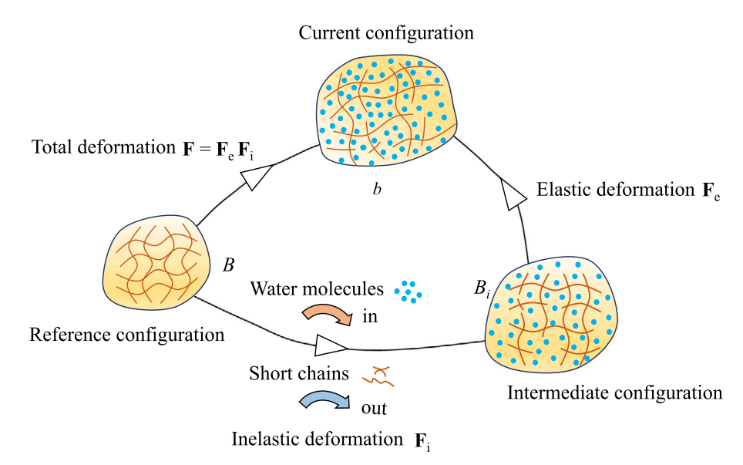
Constitutive Model: Hydrolytic Degradation
Diffusion-Deformation-Degradation
Inelastic Deformation (Fi​)
Water molecules enter the polymer network,
causing it to swell.
Simultaneously, short polymer chains
formed by hydrolysis leave the network.
Elastic Deformation(Fe)
From the intermediate configuration,
the network undergoes elastic stretching or
compression to reach the final shape in the
current configuration.
(swelling)
(Chain scission)
Pan, Z., & Brassart, L. (2022). Constitutive modelling of hydrolytic degradation in hydrogels. Journal of the Mechanics and Physics of Solids, 165, 104902. https://doi.org/10.1016/j.jmps.2022.104902

Slide 9
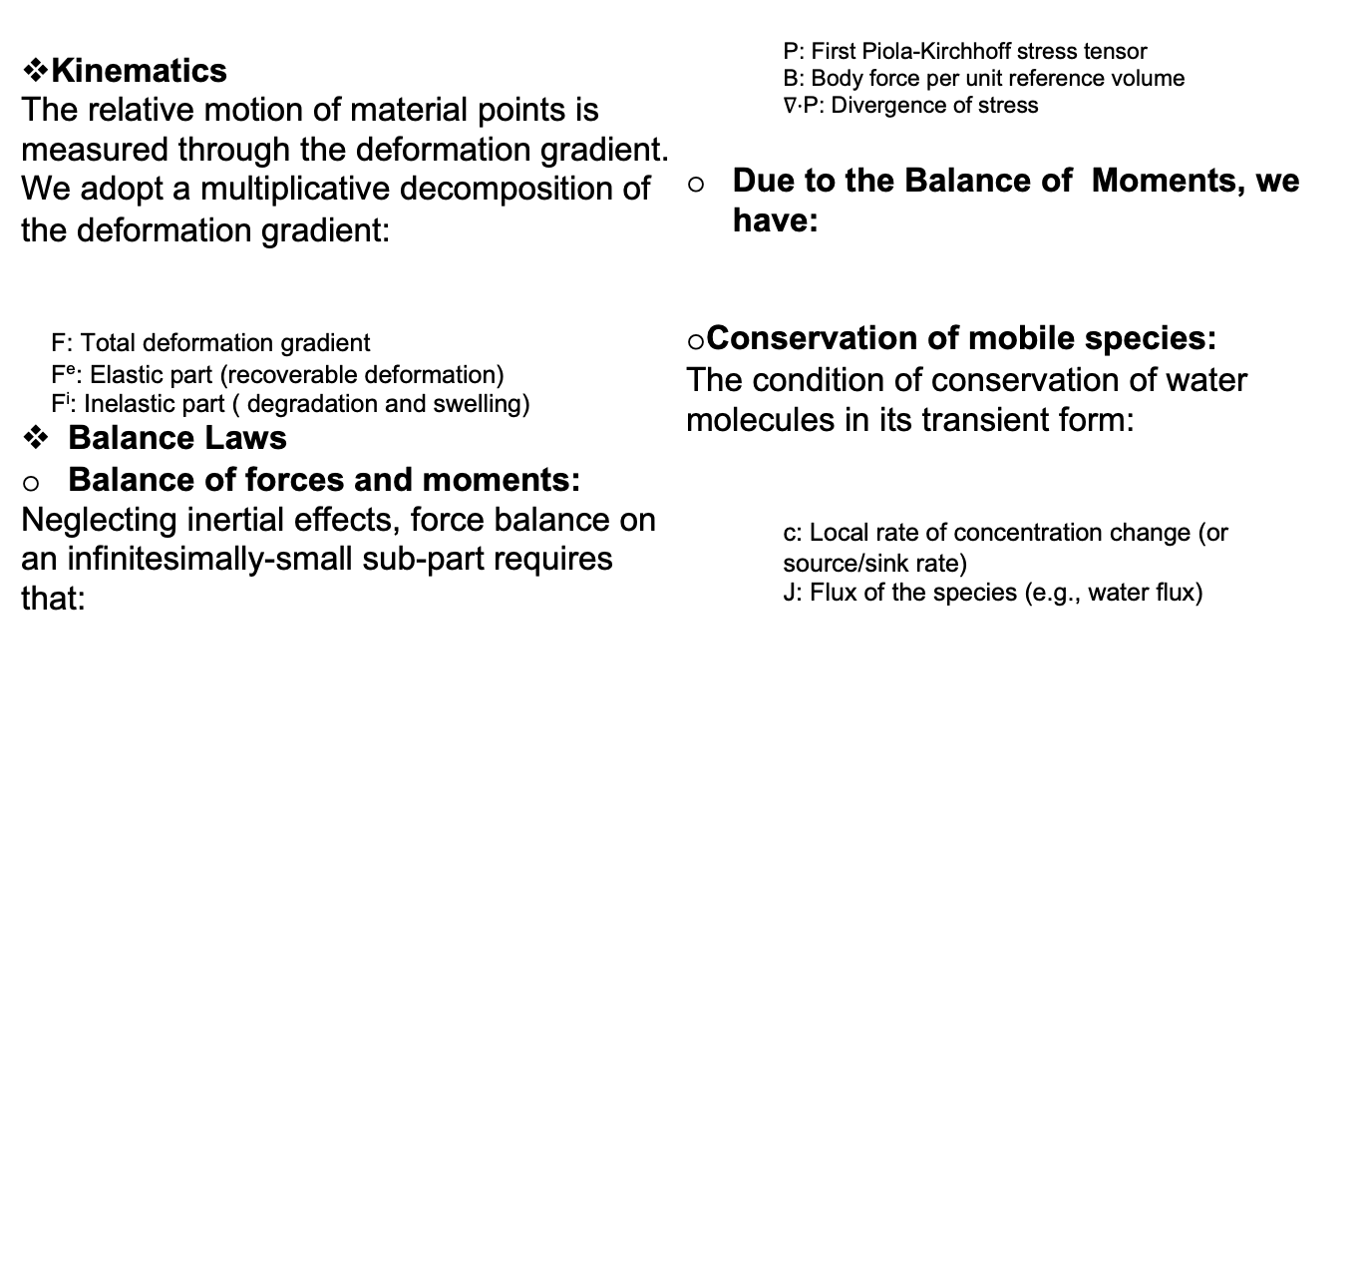




Continuum Thermodynamics Framework

Slide 10
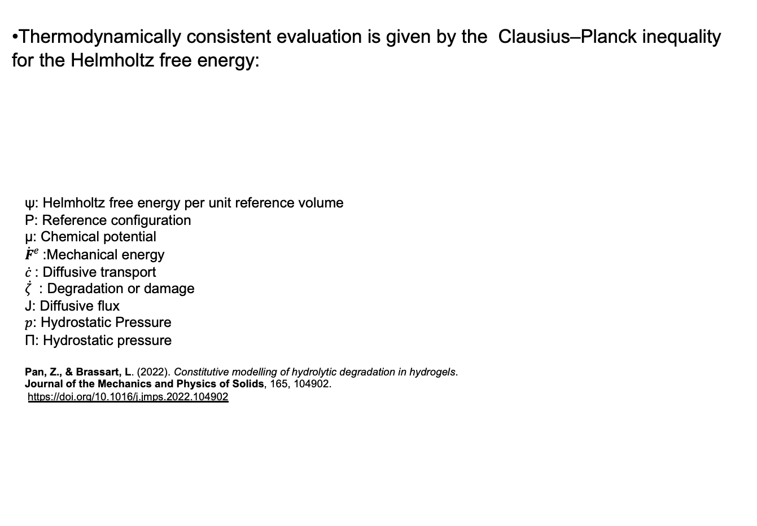
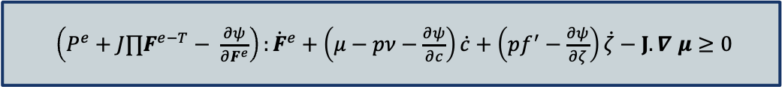

Free Energy Imbalance and State Equations
ψ_{mech}
ψ_{mix}
Ψ_{deg}

Slide 11
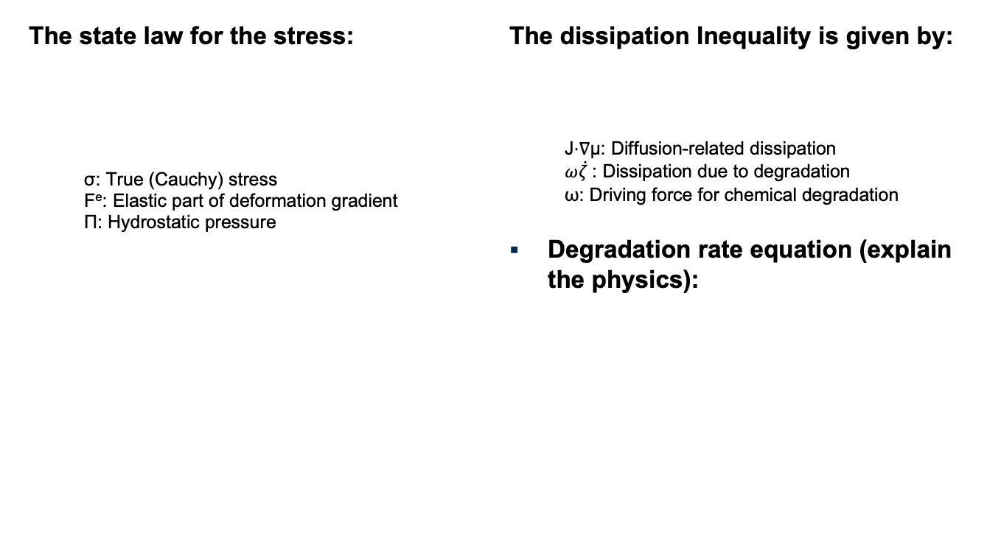
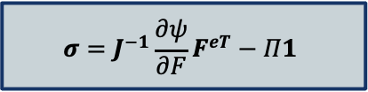


Cont..

Slide 12
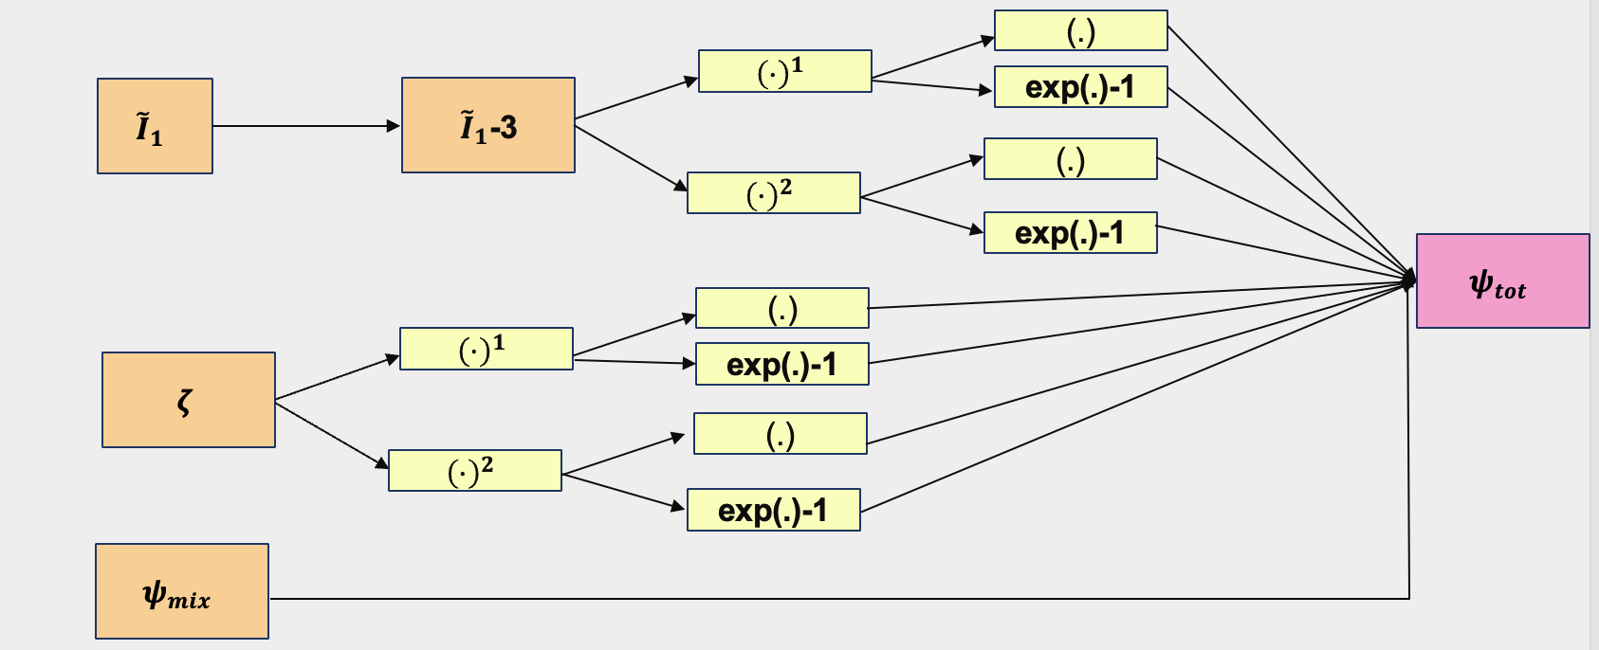
Network Architecture of Helmholtz Free Energy And Design Constraints
To ensure the free energy satisfies the physical constraint the activation function should be:
Linear
Exponential
Quadratic
Logarithmic
Holthusen, H., Lamm, L., Brepols, T., Reese, S., & Kuhl, E. (2024). Theory and implementation of inelastic Constitutive Artificial Neural Networks. Computer Methods in Applied Mechanics and Engineering, 428, 117063. https://doi.org/10.1016/j.cma.2024.117063

Slide 13
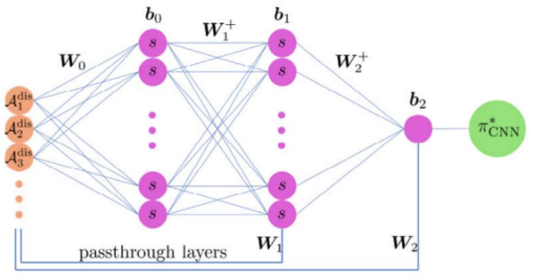
Inelasticity through degradation variable
This module predicts the next degradation state ζ_{n+1} using a physics-informed neural network, where: The rate is guided by kinetics.
Non-negativity and upper bounds are enforced via activations- are convex and non-decreasing. Weights are non-negative.
Benefits:
Smooth and differentiable
Physically constrained output
Compatible with ML-based constitutive modeling
B. Amos, L. Xu, and J. Z. Kolter, Input Convex Neural Networks,Proc. 34th Int. Conf. Mach. Learn. (ICML), pp. 146–155, 2017

Slide 14
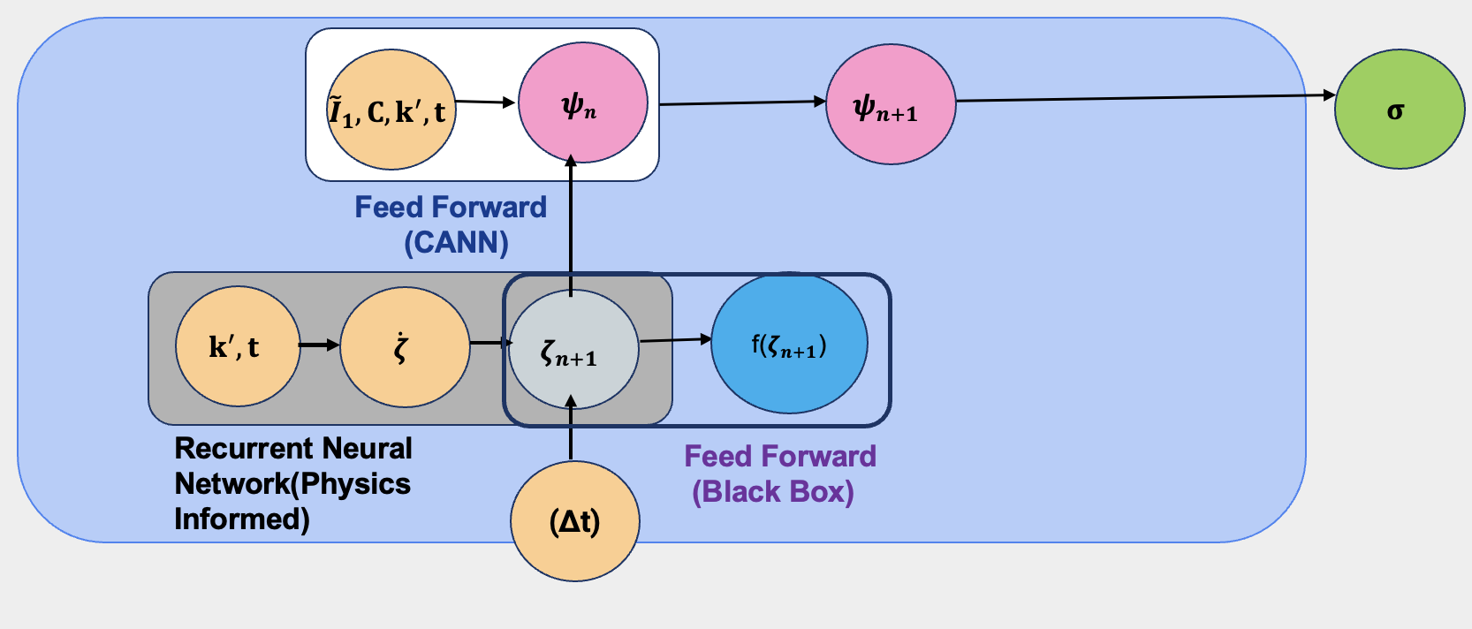
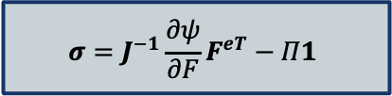
Full Neural Network Layer
From free swelling experiments, the input features include:
I₁ (invariant of the deformation gradient)
k′ (degradation rate constant)
ζ (degradation variable)
Δt (time step)
Output targets:
Hydrostatic pressure Π
Mass loss fraction f(ζ)
Final predicted quantity: Stress σ, derived
from the state law:
`

Slide 15
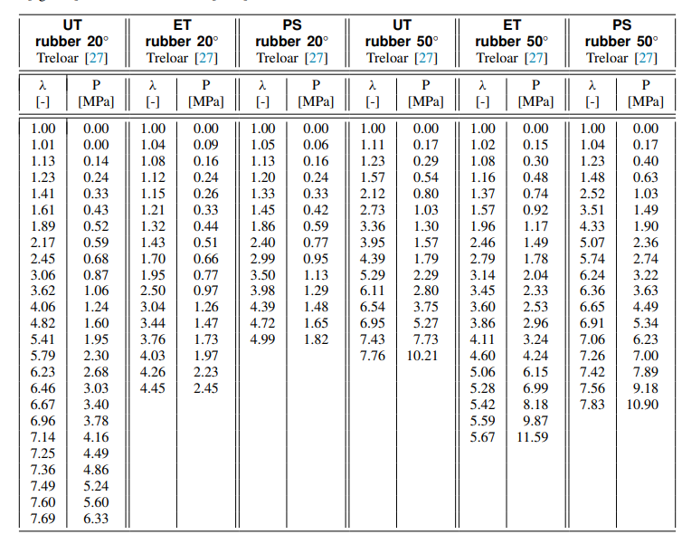
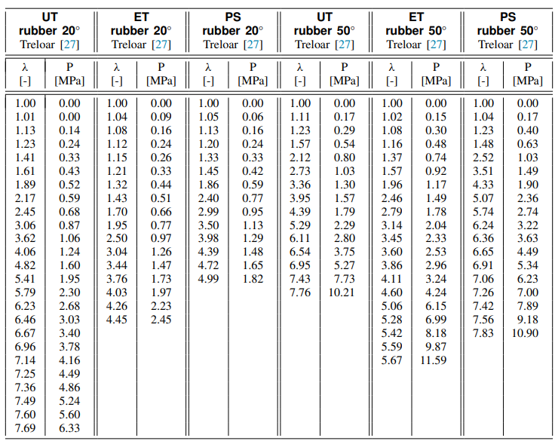
Experimental Data Used For Training
Benchmark Stress–Stretch Data for Single-Mode Training
Benchmark Stress–Stretch Data for Multi-Mode Training
and rubber data reported in psi units[2].
Table 1-Benchmark uniaxial tension (UT) datasets were collected from multiple classical rubber elasticity studies. These include UT experiments at 20°C and 50°C for natural rubber [1], gum stock and tread stock rubber [2], as well as polymeric foam.
Table 2-Benchmark stress-stretch data for multi-mode training. Uniaxial tension (UT), equibiaxial tension (ET), and pure shear (PS) experiments for rubber at 20◦ and 50◦ [2].

Slide 16
Synthetic Data Used For Training
A synthetic dataset for training the MiCANN model is adapted from Brassart’s model.
Material Model Used: Gent Hyperelastic Model
Captures strain-stiffening behavior
Combined with:
Flory-Huggins mixing energy
Quadratic reaction (degradation) energy
Simulated across multiple degradation levels
Modeling free swelling behavior for Tetra-PEG Hydrogels and PLA-b-PEG-b-PLA (Total polymer weight fraction: 50 wt%)
Degradation data is generated by a first-order kinetics
Training Set (80%) - Enables learning of key patterns, such as stiffness evolution and mass loss over time
Testing Set (20%)- Used to evaluate the model's ability to generalize to unseen data
Includes representative samples across all degradation regimes

Slide 17
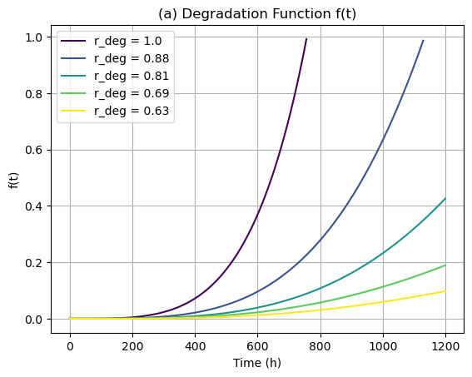
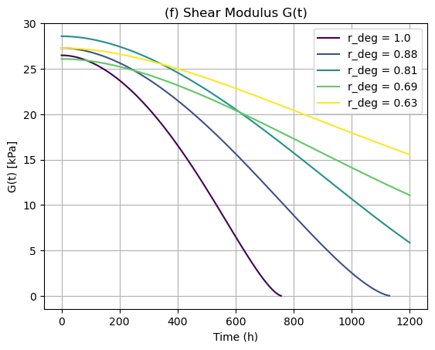
Synthetic data Generation for PEG based hydrogels
a) Mass loss vs time
b) Shear Modulus vs time
Successfully implemented the degradation model from Brassart et al. to simulate:
a) Mass loss evolution f(t)
b) Modulus evolution G(t)
Captures the physics of network degradation, reaction kinetics, and swelling thermodynamics
Produces smooth, physically consistent data across multiple degradation levels and k′ values
Pan, Z., & Brassart, L. (2022). Constitutive modelling of hydrolytic degradation in hydrogels.
Journal of the Mechanics and Physics of Solids, 165, 104902.

Slide 18
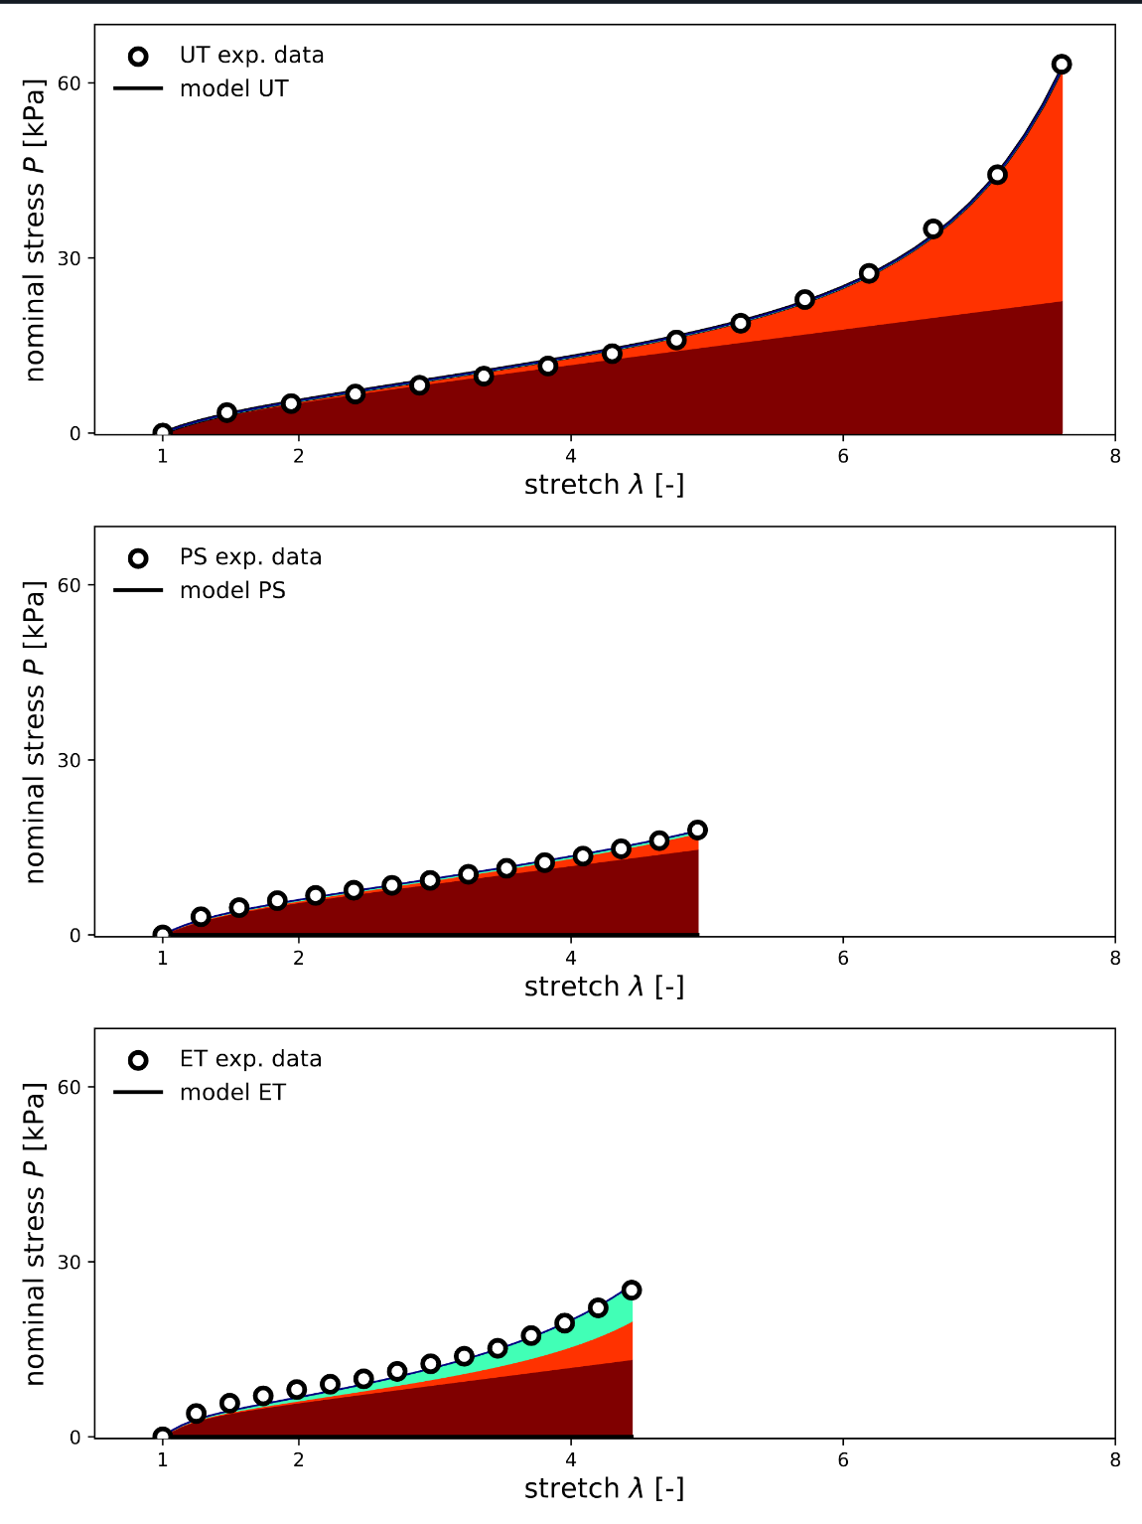
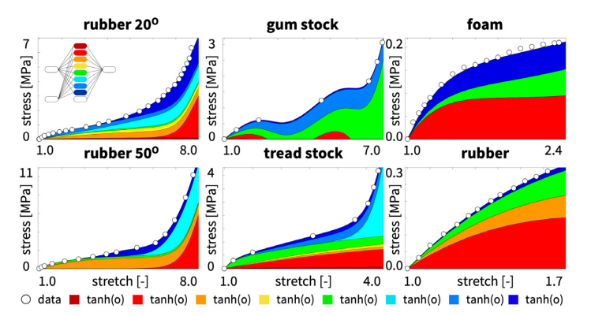
Constitutive Artificial Neural Networks describe and predict well and prevent overfitting
Fig. 8. Classical Neural Network. Uniaxial tension. Piola stress P(λ) as a function of the stretch λ for a fully connected feed forward Neural Network with one layer, eight nodes, 16 weights, and nine biases, using the hyperbolic tangent activation function
Fig 9-Constitutive Artificial Neural Network. Uniaxial tension, equibiaxial tension, and pure shear. Piola stress P(λ) as a function of the stretch λ for the feed forward Constitutive Artificial Neural Network [2]

Slide 19
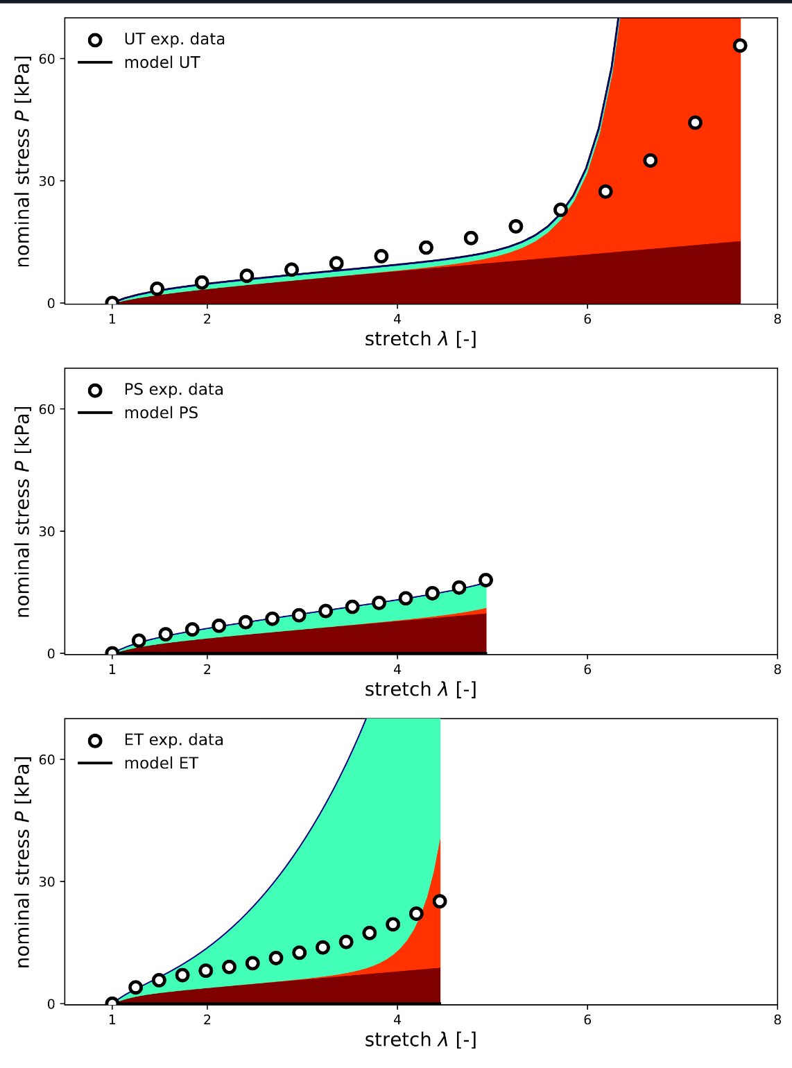
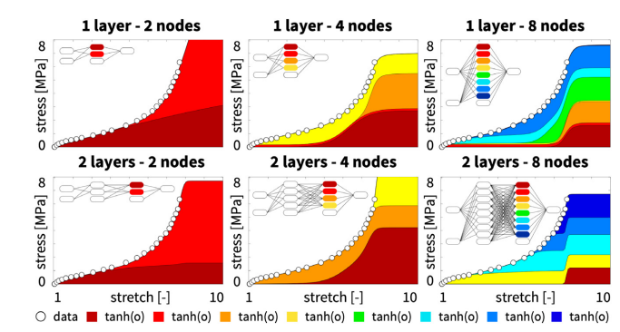
Classical Neural Networks can describe data well but cannot predict beyond the training regime
Fig 6- Classical Neural Networks. Effect of network depth and breadth. Piola stress P(λ) as a function of the stretch λ for six fully connected feed forward Neural Networks with one and two layers and two, four, and eight nodes[2]
Fig 7-Constitutive Artificial Neural Network. Uniaxial tension, equibiaxial tension, and pure shear. Piola stress P(λ) as a function of the stretch λ for the feed forward Constitutive Artificial Neural Network [2]

Slide 20
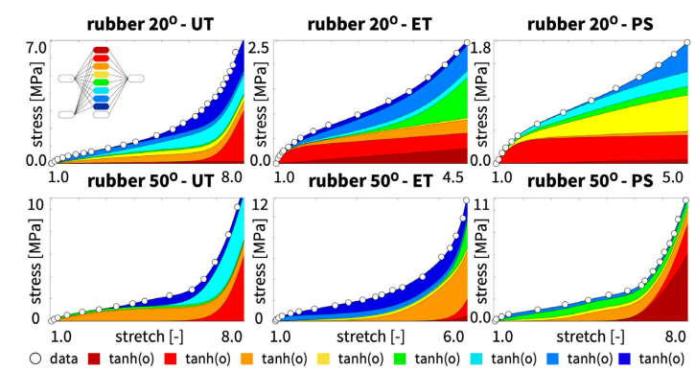
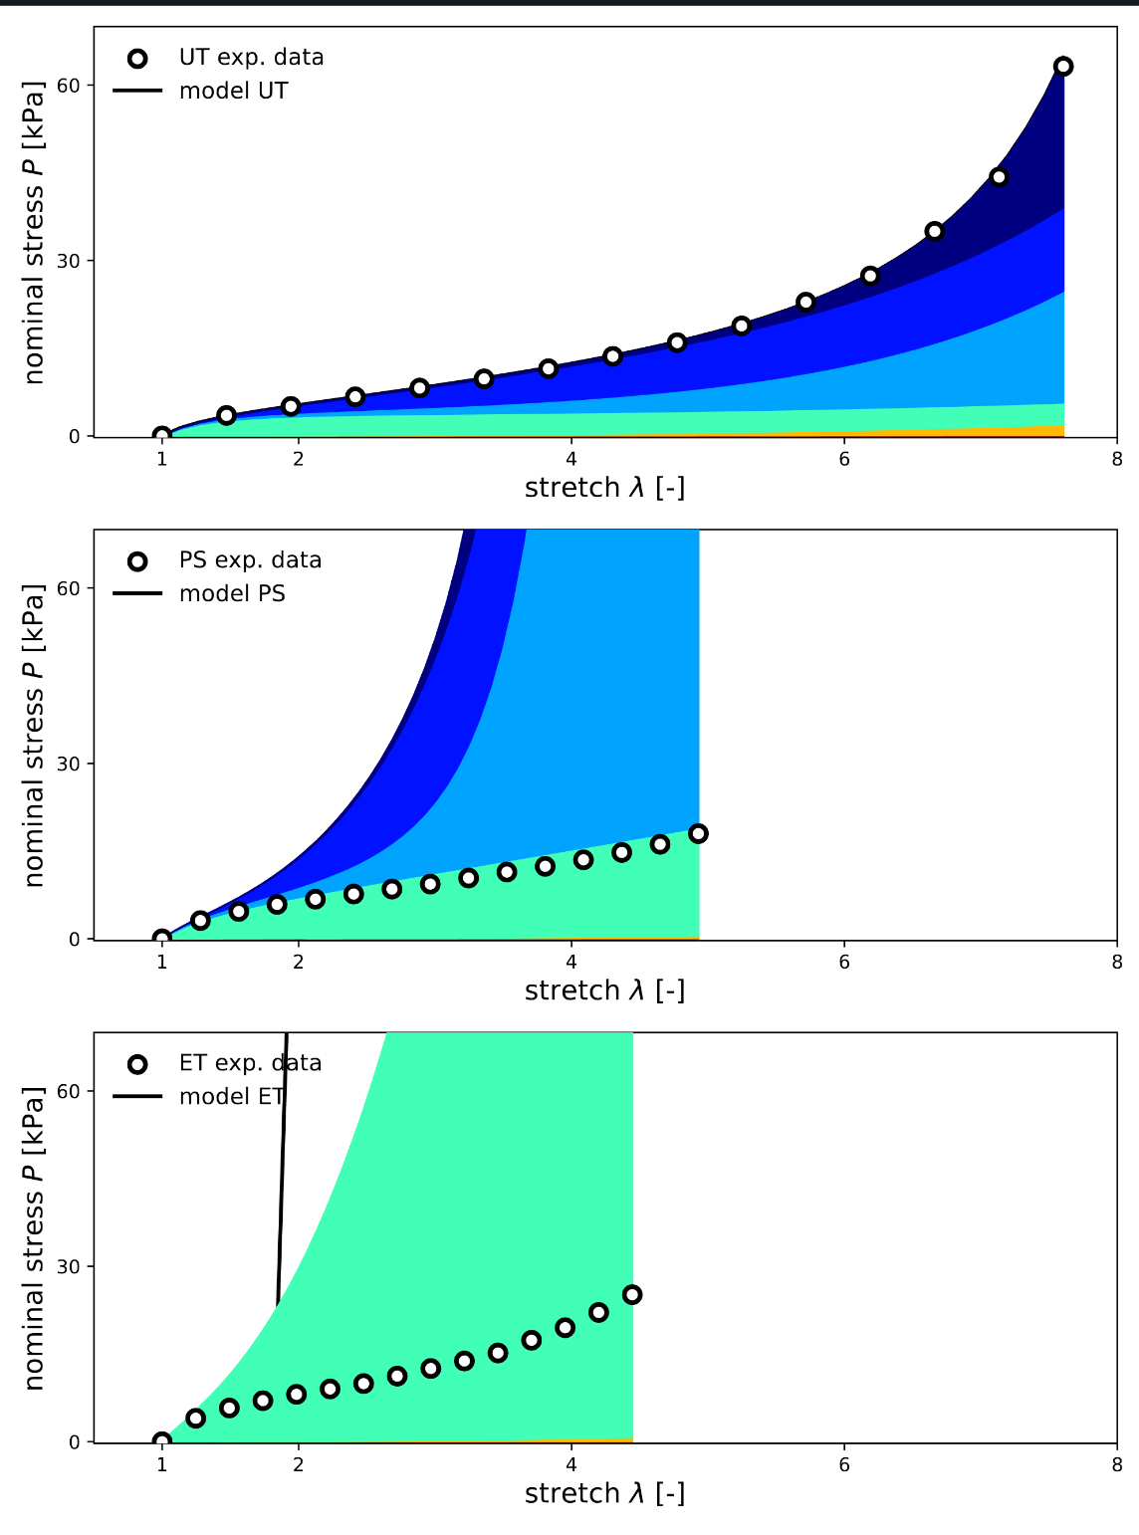
Classical Neural Networks perform well for multi-mode data but provide no physical insight
Fig. 8- Classical Neural Network. Uniaxial tension, equibiaxial tension, and pure shear. Piola stress P(λ) as a function of the stretch λ for a fully connected feed forward Neural Network with one layer, eight nodes, 16 weights, and nine biases, using the hyperbolic tangent activation function
Fig 9-Constitutive Artificial Neural Network. Uniaxial tension, equibiaxial tension, and pure shear. Piola stress P(λ) as a function of the stretch λ for the feed forward Constitutive Artificial Neural Network [2]

Slide 21
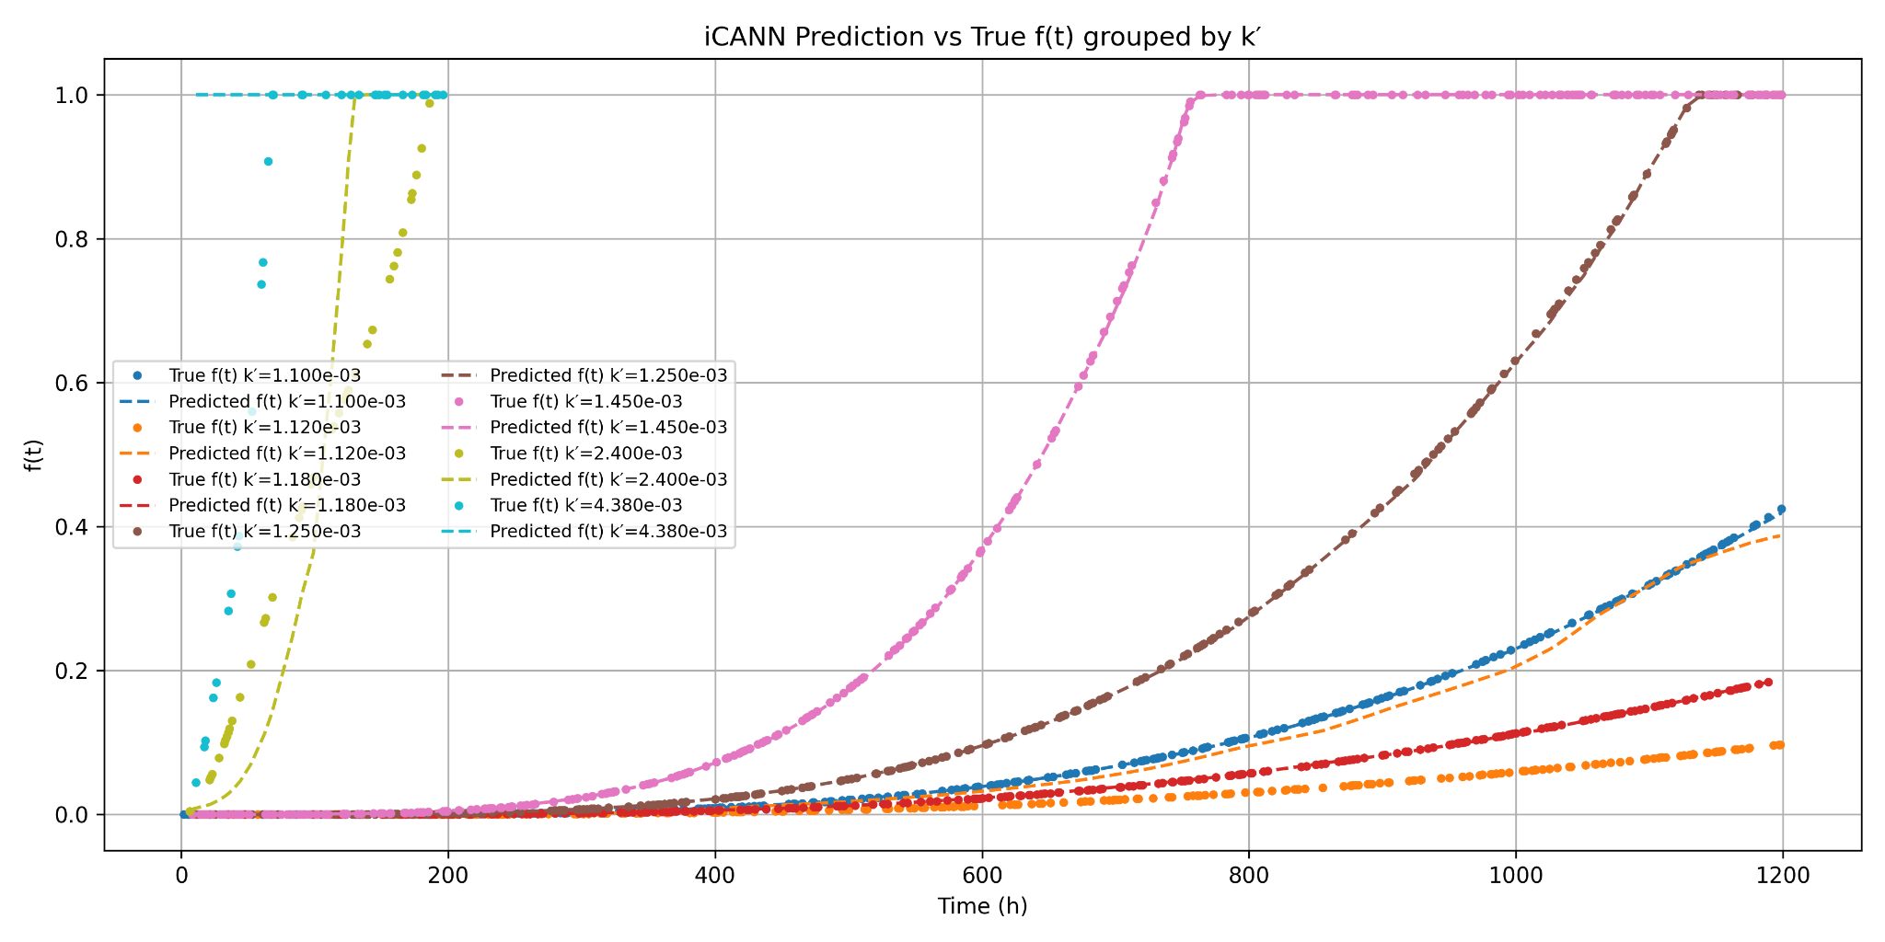
Preliminary Result-Predicted Vs Actual Mass Loss
Training the iCANN model on a cleaned, diversified dataset (including Tetra-PEG and PLA-b-PEG) and increasing the number of layers significantly improved its ability to capture degradation trends f(t), especially across a wider range of reaction rates k′.
The model achieves accurate early-time predictions and better captures saturation behavior as f(t)→1, validating the importance of data quality and chemical variety in enhancing learning performance.

Slide 22
Conclusion
Despite the data limitations, the MiCANN model demonstrates strong agreement between predicted and true degradation responses in free swelling.
When trained on richer and cleaner, more balanced datasets, the model shows improved prediction accuracy, reinforcing the need for better experimental data generation.

Slide 23
Future Work
Enhance Model Interpretability
Explore physics-informed models to reveal dominant physical trends learned by the neural network.
Data Augmentation & Simulation
Use physics-based simulations to augment training data and improve the robustness of the model in extrapolative regimes.
Generalize the MiCANN framework to accommodate a wide range of hydrogels
Surface Degradation should be considered in future work

Slide 24
Thank you!

